Slide 1
Consumer Debit Card: Predictive Analytics to Target Customers for Activation Aug 18, 2016 Stacy Li
CONFIDENTIAL - DO NOT DISTRIBUTE

Slide 2
Agenda
How Do We Add Debit User in A Profitable Way?
Size the Opportunity
2014 Campaign Review
Modeling
Campaign Result Forecast
Future Consideration

Slide 3
How Do We Increase Debit User in A Profitable Way?
Find customers likely to respond to campaign
Find customers likely to spend > $1000 in the first three months
Increase interchange revenue

Slide 4
Sizing the Opportunity
A sizable group of more than 60,000 existing DDA customers don’t have an active debit card
Debit card provides the largest tangible incremental profit for services groups
Cross-selling opportunities
8/18/2016
CONFIDENTIAL - DO NOT DISTRIBUTE

Slide 5
Sizing the Opportunity
Debit Card profit peaks in the 41-45 customer age bucket before going downward
The younger we get customer using a debit card, the more potential value we capture
Notes: 1) Personal DDA accounts only; 2)Consumer service groups shown have at least 4,000 relationships; 3)Nov 2013 data.

Slide 6
2014 Campaign Review
Question: Who has a need for debit card?
Recap of campaign: 10,394 emails sent -> 3910 opened (37.6%) ->159 responded (1.5%) -> 91 continued spending over $1000 in total in 3 months (57.2%)
Notes:
The goal is get more people use debit card and encourage low-usage ones to spend more. To do this, what critical question we need to ask?
First, learn from the past

Slide 7
Modeling- Who qualifies?
Define exclusion rules:
Retain only consumer (Age 20-85; RTC account=0; Boarding date before 2016)
Exclude customers who don’t have a deposit account
Remove customers on the Do Not Contact list
Exclude customer whose accumulated spend over $200 in the past six months

Slide 8
Modeling- Ideas behind the model
2016 Response Model-Q1
Data source: 2014 campaign data
Model mechanism: Compare respondent group with non-respondent group to identify characteristics having predictive power

Slide 9
Modeling- Ideas behind the model
2016 Profitability Model-Q2
Data source: Debit activity of new users in January 2016
Model mechanism:
Group A (>$1000) VS. Group B(<=$1000)
Monitor their spend
Jan.
Feb.
Mar.
Apr.
May.
Jun.
Find customer who activate a new card at this point

Slide 10
Modeling-Factors in the final model
2016 Response model
Age
ATMRange
NASbuck
HOBucket
BillPay
BranchRange
Deposit Balance
DigitalInFlag
RMAge
2016 Profitability model
Age
ATMRange
NASbuck
HOBucket
Billpay
BranchRange
Deposit Balance
DigitalInFlag
Annual Profit Per Relationship
Loan Balance
Education

Slide 11
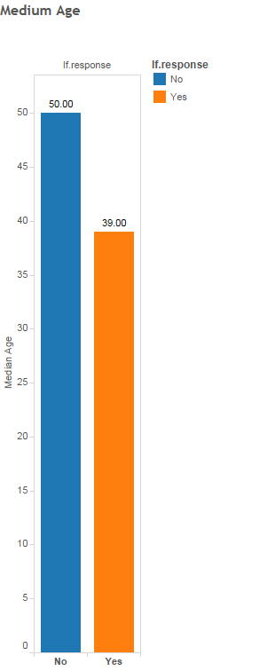
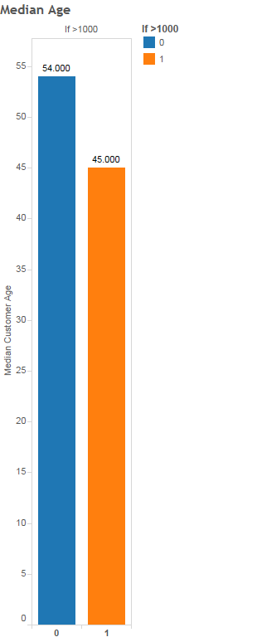
Modeling-Factors in the final model
Age-Response model
Age-Profitability model
Young people are more likely to respond and keep spending

Slide 12
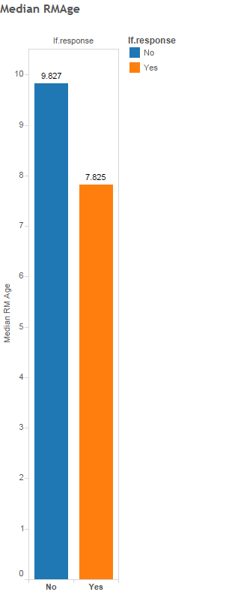
Modeling-Factors in the final model
RMAge-Response model
Customers in response group have a lower average Relationship Age (i.e., tenure)

Slide 13
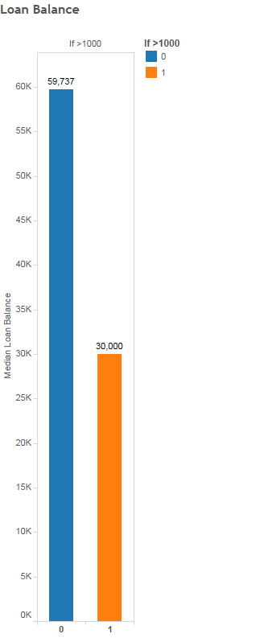
Modeling-Factors in the final model
Loan Balance-Profitability model
Customers in the response group have a lower average loan balance

Slide 14
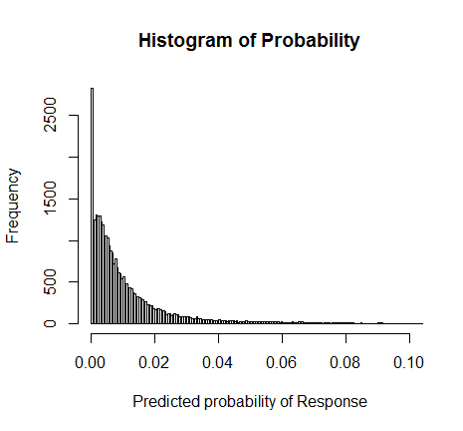
Model Result-Response
1.5%
If the predicted probability of a customer is considerably higher than 1.5% (response rate in 2014), we want to target this customer

Slide 15
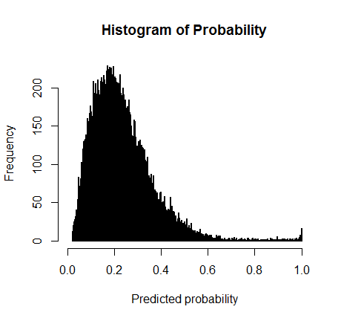
Model Result-Profitability
23.8%
If the predicted probability is considerably higher than 23.8% (the percentage of people spending 1000+), we want to target this customer

Slide 16
Campaign Result Forecast
 | 2016 Activation | 2014 Activation
Total Email Sent | 13469 | 10394
Response Rate | 2.196% | 1.5%
Estimated Number of Respondent | 296 | 159

Slide 17



Future Consideration -Clusters
Young Professionals
Age: 27-31
Deposit: <$7,000
Loan: $0-$2,500
Generation X
Age: 42-47
Deposit: $4,000-$13,000
Loan:$29-$154
Boomers
Age: 58-61
Deposit: $20,000-$200,000
Loan:$400-$3,046

Slide 18
Future Consideration-Control Group
Also send out email to some customer not selected by model to test prediction power of model.
If the model is working well, the response rate of control group should be much lower than targeted customers.

Slide 19
Summary
By answering Who is going to respond and Who is going spend more than $1000 in the first three months after activation, we are trying to identify profitable customers for debit card activation
13469 emails were sent and we expect to receive 296 responses. Estimated response rate is 2.2%.
The model needs constant effort to improve.

